Slide 1
Coniston Memorial Proposal
Approvals required/received
Existing Situation
Proposal - Phase 1
Other Items – Phase 2
Financial Considerations
Next Steps

Slide 2
Approvals Required/Received
Legion is responsible for the maintenance and erection of the site. Falconbridge Legion looks over Coniston Site. Have received approval from Falconbridge Legion (Ron Rivais)
Received approval from Legion District H Liaison Officer for Monuments (Ron Robitaille)
Received approval from Coniston Community Action Network (CAN) (Jim Sartor) and executive
Received approval and a great deal of support from Barb McDougall-Murdoch Community Development Co-ordinator
Received support and approval from Councillor Doug Craig (Ward 9)
Received approval from City of Greater Sudbury Parks Manager (Pam Cranston)
Received approval from City of Greater Sudbury Risk Manager
Received approval from City of Greater Sudbury Building Services (no requirement for detail drawings and no permit required) (Bill McCaffery)

Slide 3
Existing Situation
Memorial was damaged and requires significant repair and restoration
Not in a highly visible area of town
Placed there due to previous bandstand that was there
Subject to vandalism due to being away from traffic both vehicle and pedestrian

Slide 4
Existing Situation
Entire site needs restoration beyond damage that was done
There is another memorial in park that is also not in a highly visible area of the park that is in good condition
Park does not seem organized with items spread around with what appears to be no order/reason

Slide 5
Memorial Proposal Phase 1
Use current situation as an opportunity
Take advantage of fact that new work needs to be done and consolidate to one memorial
Use items from previous memorials and tie them both in together
Place in highly visual part of town (corner of Second Ave and Government Rd.)
Make as a focal point in town that is visually appealing and inviting to all

Slide 6
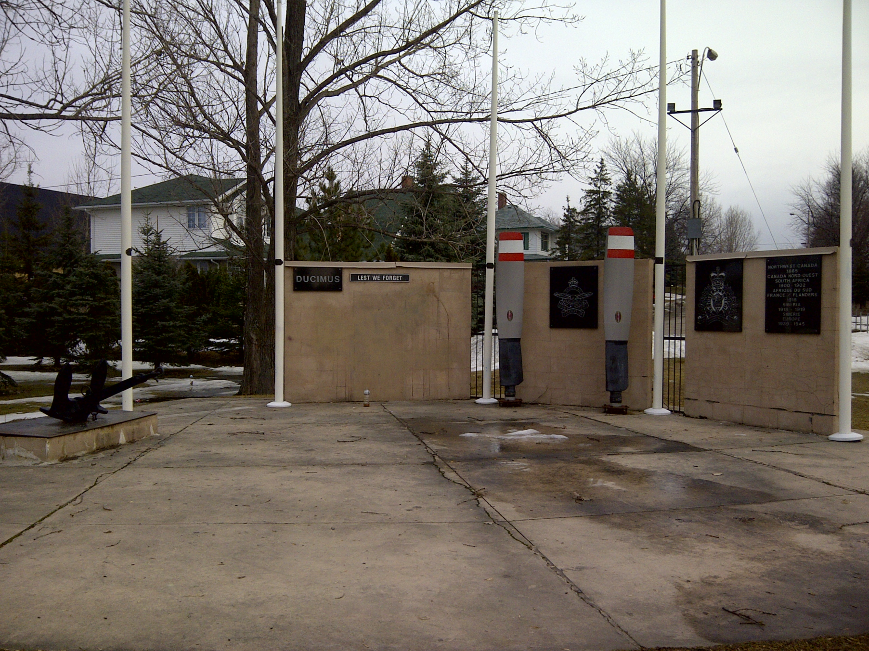
Memorial Site Current

Slide 7
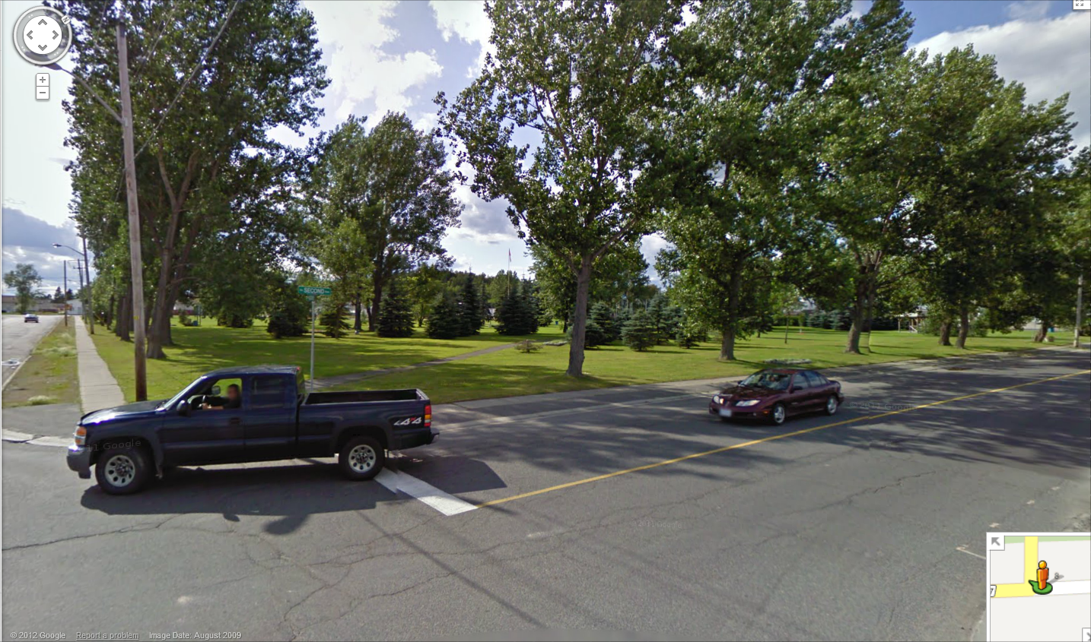
Memorial Proposed Site

Slide 8
Memorial Proposed Site

Slide 9
Memorial Proposed Site Details
Spotlight on pole directed at flag/monument to light up at night. Will reflect image in pool at night as well
(Potentially surveillance camera as well)
Two benches angled in at 45 facing memorial
Flag of Canada, Ontario and Greater Sudbury behind the Memorial
Centennial Plaque to be moved to corner of Park and refinished
Army, Navy (anchor), Air Force
RCMP and Merchant Marine plaques laid out in a half circle around rear of memorial.
Plaques placed on poured concrete pillar same dimensions as the Centennial pillar and finished in black concrete finish
Reflection Pool (approx. 1 1/2 feet deep) 7’ by 3’. Will reflect image of memorial in pond.

Slide 10
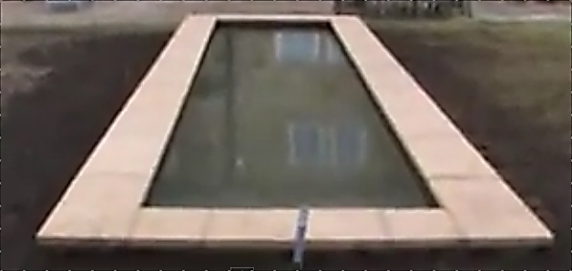
Sample of Reflecting Pool
Note: have detailed instructions how to build

Slide 11
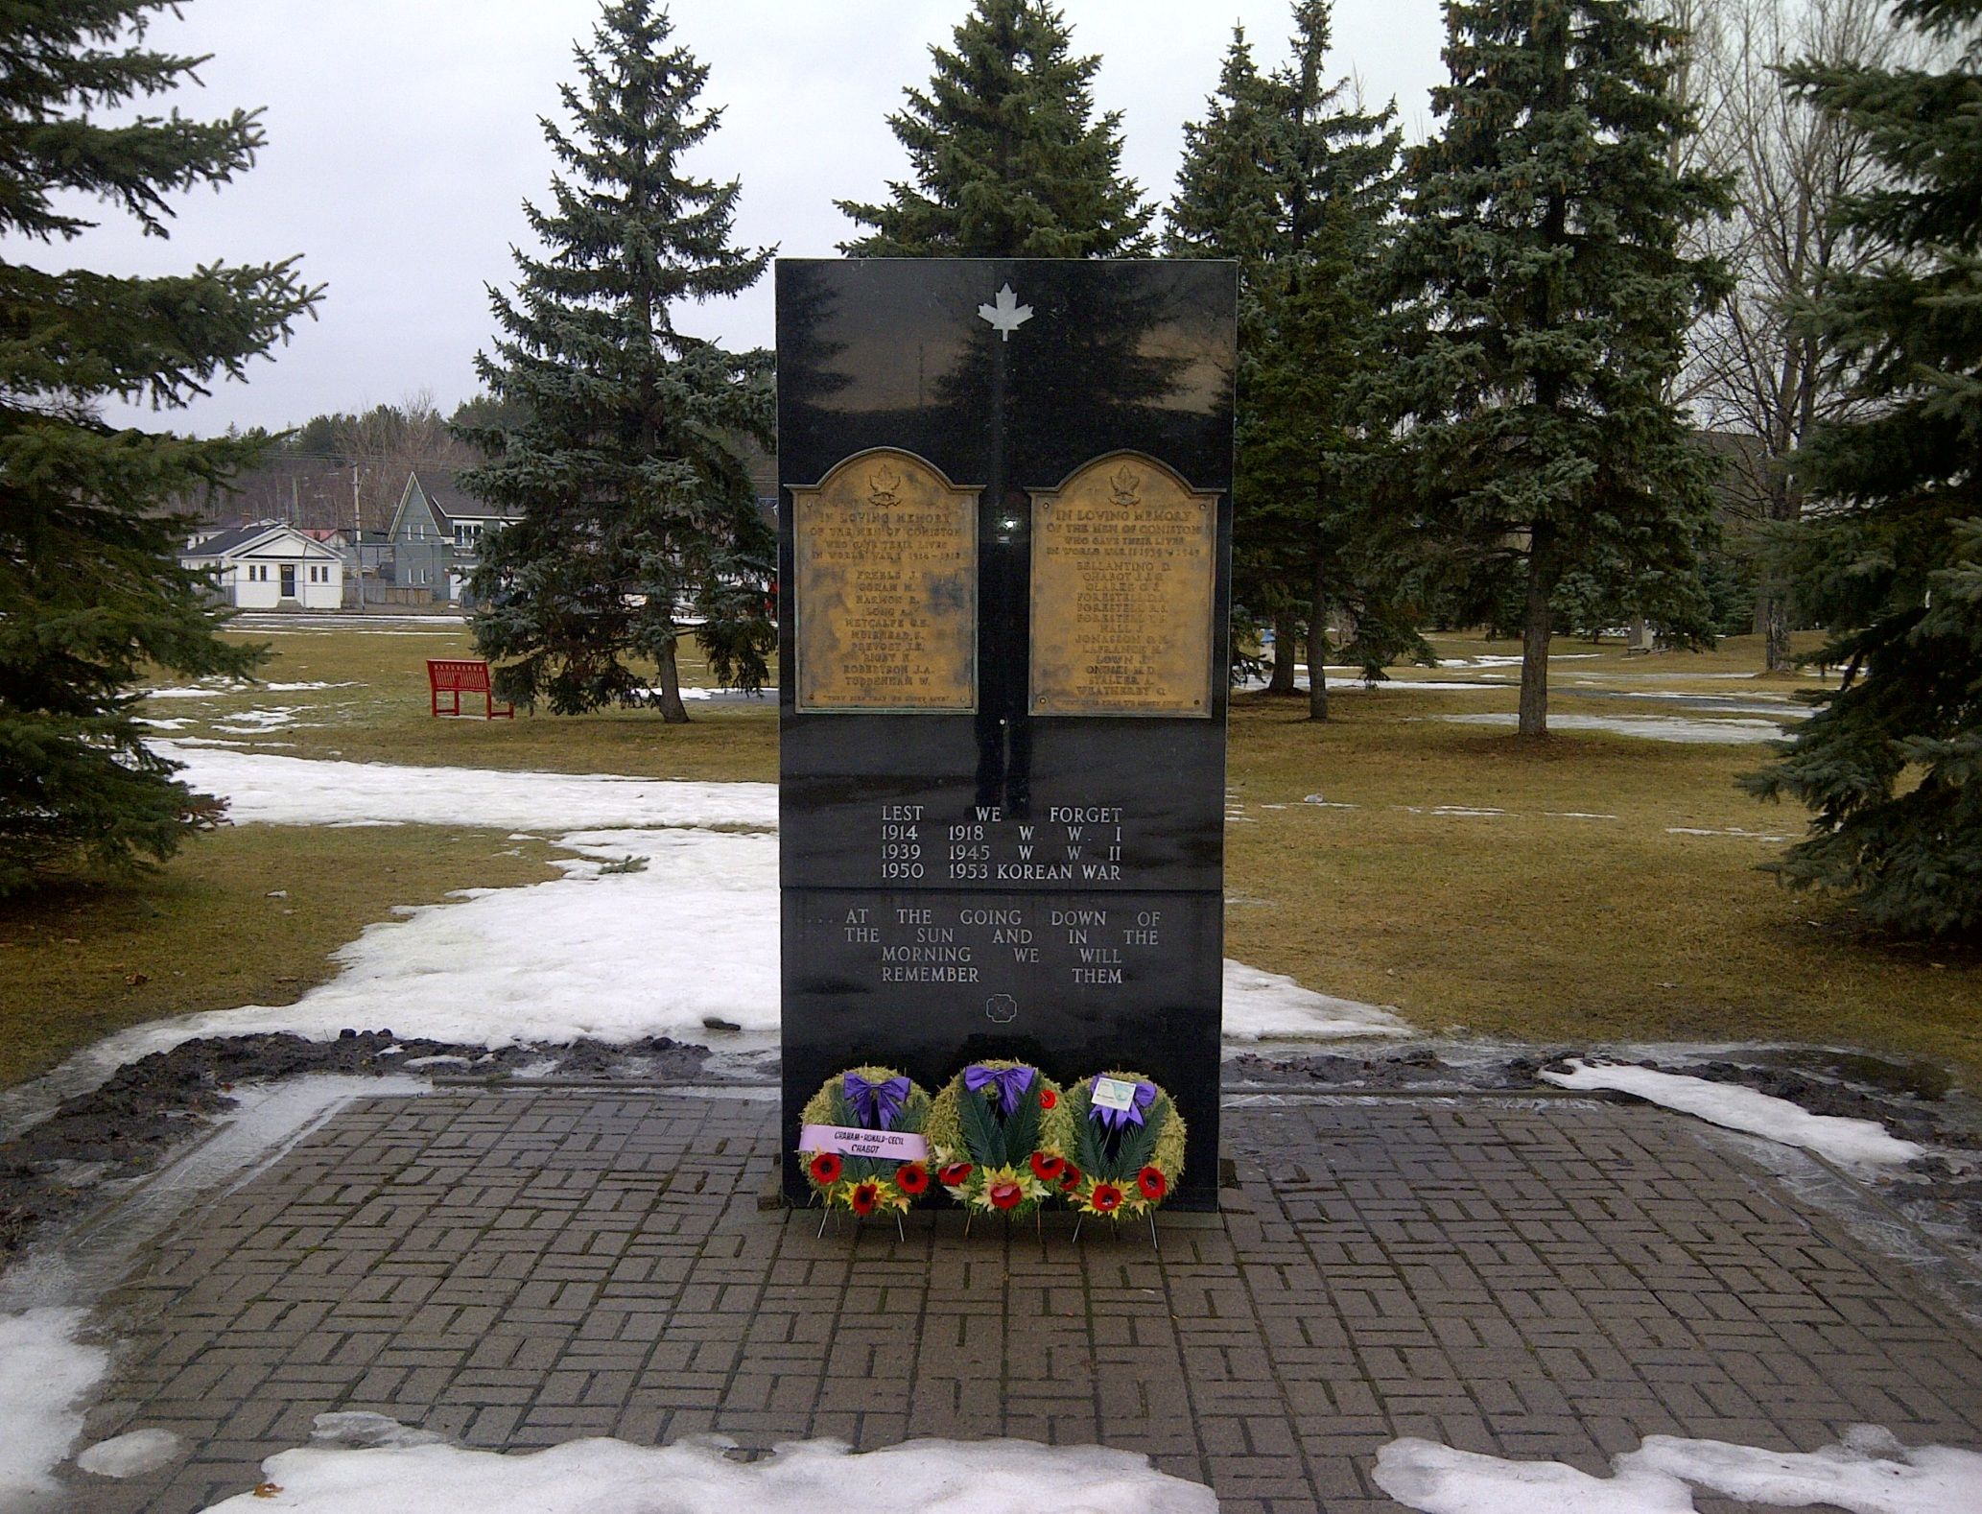
Memorial
Current Memorial in good shape (only need to polish up plaques)

Slide 12
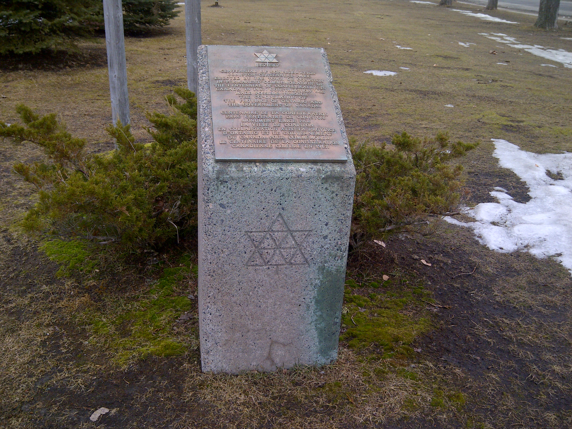
Centennial Plaque
Re-finish in Black finish and use same dimensions for memorial items that go around main memorial (need to polish this plaque as well)

Slide 13
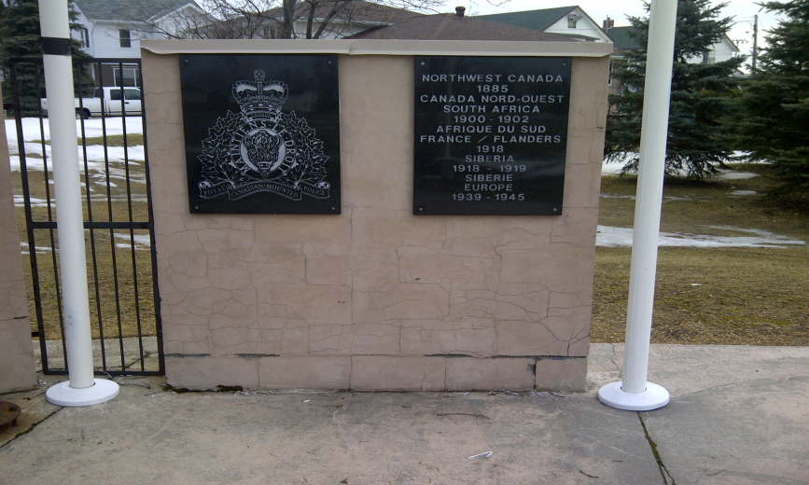
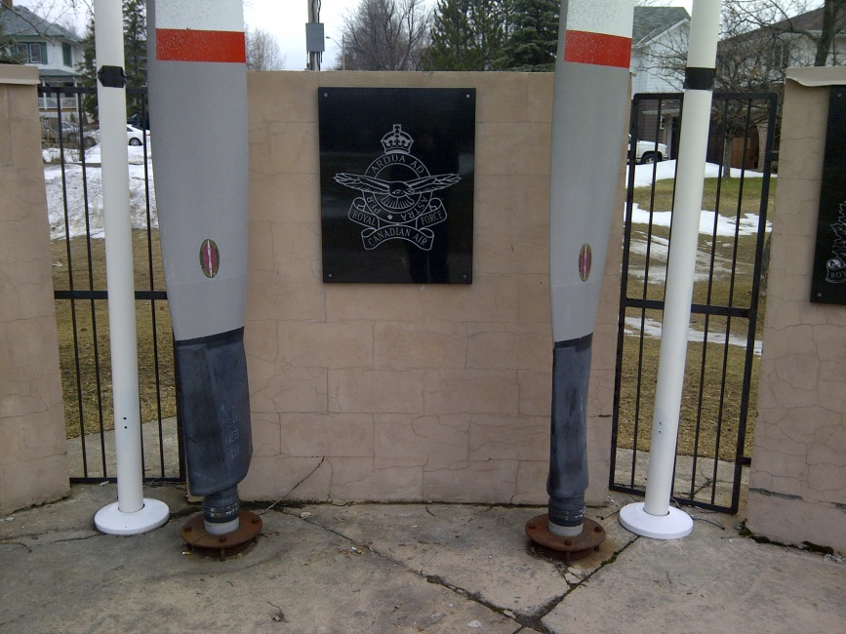
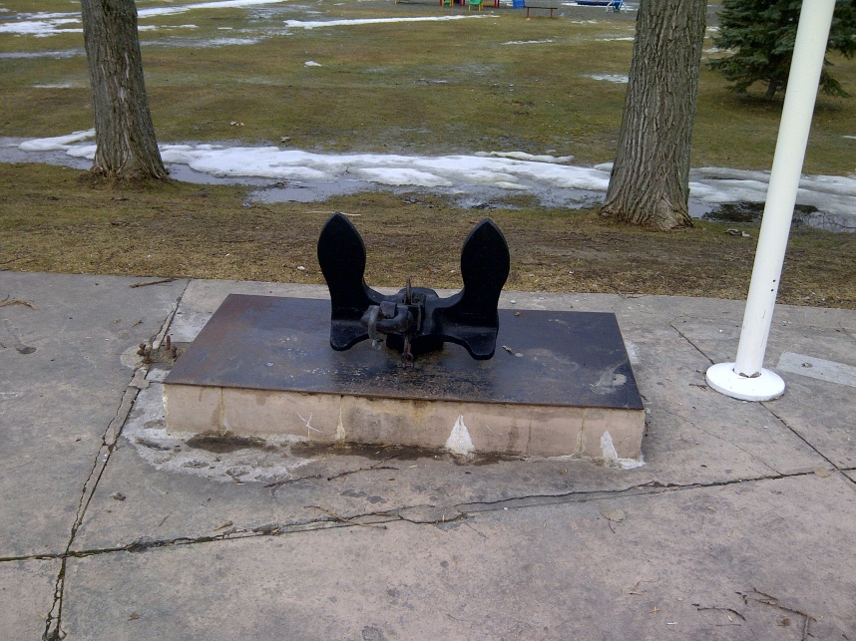
Items to be Placed around Memorial
Merchant Marine plaque to be re-done if not found
Look into Army cross sword and Maple Leaf done in same black marble as other items
Note: Item not there, proposed item to create
All items (except anchor, stays on same set up as it is currently) to be placed on concrete pillar with similar dimensions as the Centennial pillar (RCMP logo on top and RCMP events on the front)

Slide 14
Phase 2 (other items for later date)
Flagstone/interlock the walkway up to the memorial and an area around the entire memorial
Build flower gardens along sides of reflecting pool (ties in with gardens being created by schools)
Surveillance camera
Weatherproof book with biography of each person on the memorial wall fixed to one of the pillars

Slide 15
Phase 2 continued (other items for later date)
Hold annual Remembrance Day ceremony at memorial, read biography of one of the people on the memorial
Use previous memorial site as skateboard/bike park for children (contentious issue but does give kids something to do, Minnow Lake park always busy)
Site is ideal for that type of activity (flat, good size and concrete base already there)

Slide 16
Financial Considerations
Number of different scenarios that have impact on cost
Look at cost sharing with Veterans Affairs
Fund raise around town and approach local businesses for donations/labour
Can be done in stages other than the two phases suggested (i.e. reflecting pool later etc.)

